Slide 1
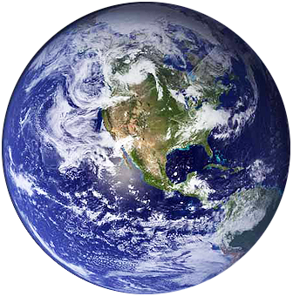

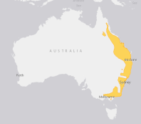

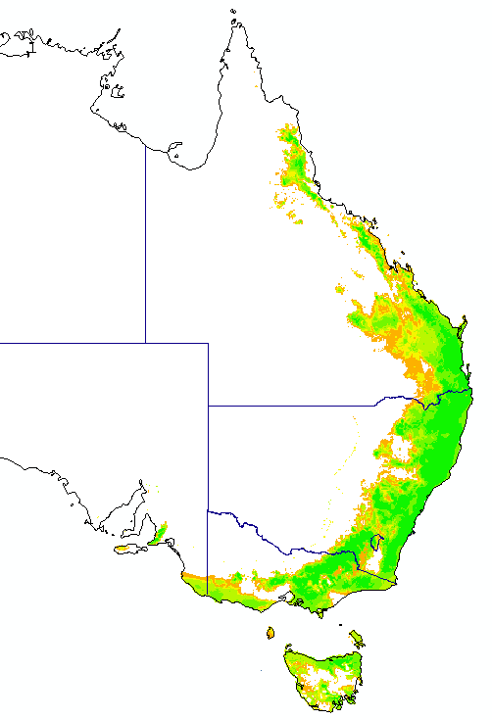
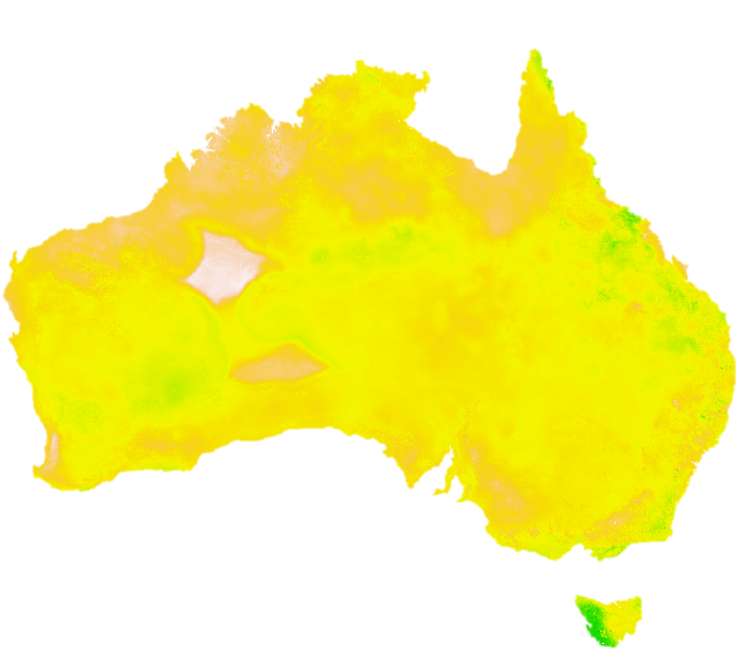

CGE: GTAP
Global scenarios
Economic model
XXX: Dyna-CLUEs
Land-use model
SDM: Maxent
IUCN range maps
Species datasets
Species distribution models
for 1000’s of species
Climate change projections
Aggregate biodiversity index of change
Biodiversity model
Socio-economic predictors
Maps of carrying capacity change
Environmental data
2010
2020
2030

